Slide 1

Cultural Heritage Experience Game
Team 4 Final Presentaion
presenter 20144824 Hong dae hwa
20144720 Choe Ju ho
Chosun Uinversity
Notes:
…

Slide 2
CONTENTS
01 02 03 04 05
Introduce game
Implement Features
Role & Development Environment
Q&A
Play video
Introducing
the game
Implemented Features
- Game Play Video
Role and Development Environment
조선대학교
Notes:
http://minheeblog.tistory.com/category/PPT

Slide 3
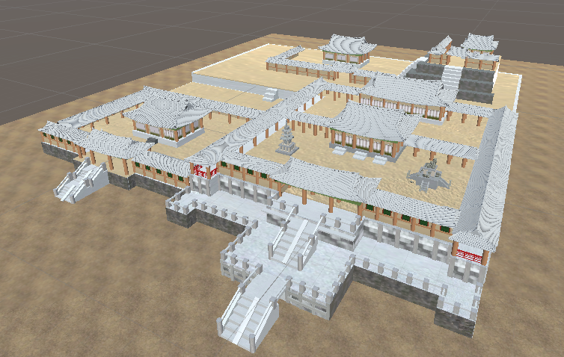
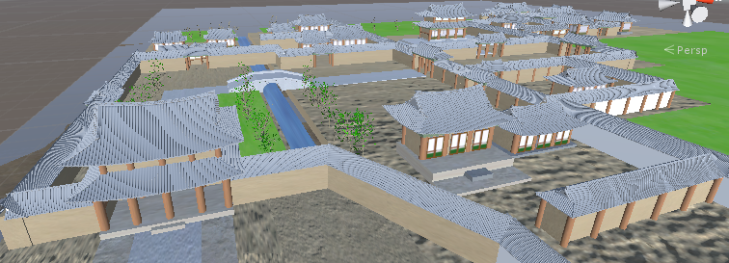
Introduce game
Cultural Heritage Experience Game
01
Cultural Heritage Experience Game
A game to introduce cultural assets that we didn't know much about while having a quiz and a cultural experience about history, and to make it easier to see and promote cultural assets by using the characteristics of games.
stage – bulguksa (Silla Dynasty) , Changdeokgung (chosun Dynasty)
Notes:
http://minheeblog.tistory.com/category/PPT

Slide 4
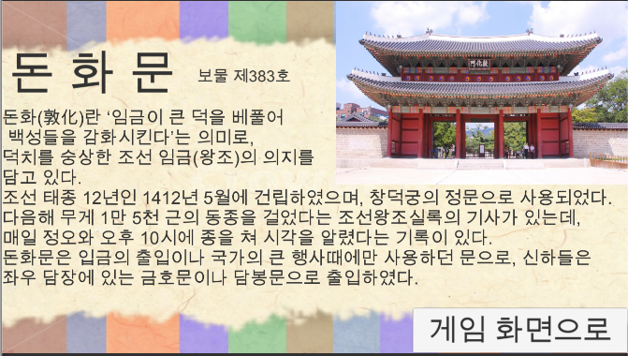
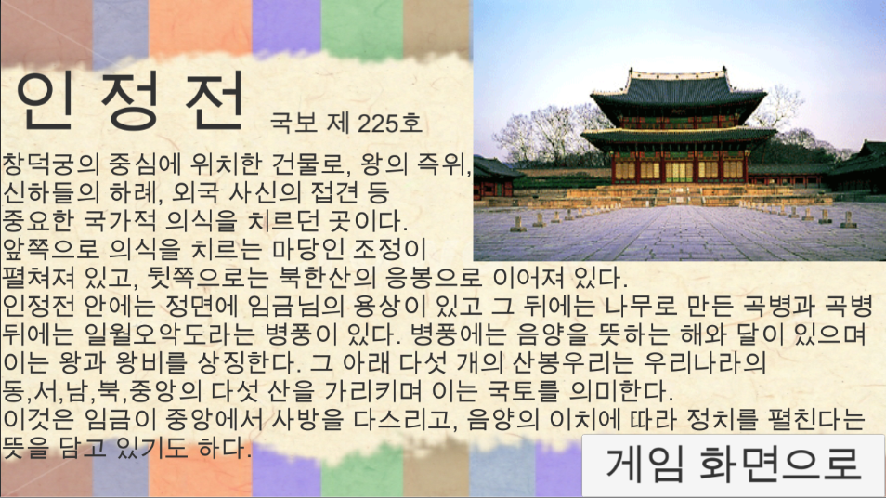
Implement Features
Cultural Heritage Experience Game
02
Introduction of Cultural Heritage
- Introducing each cultural property while playing the main cultural assets of Bulguksa Temple and Changdeokgung in each stage
Notes:
http://minheeblog.tistory.com/category/PPT

Slide 5
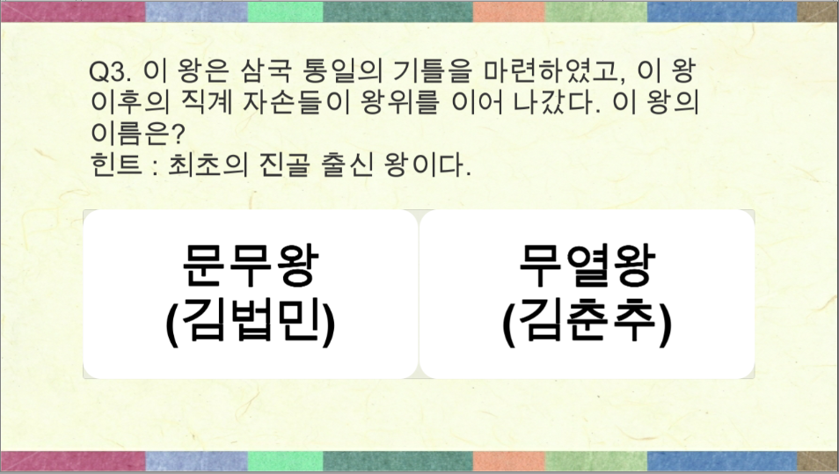
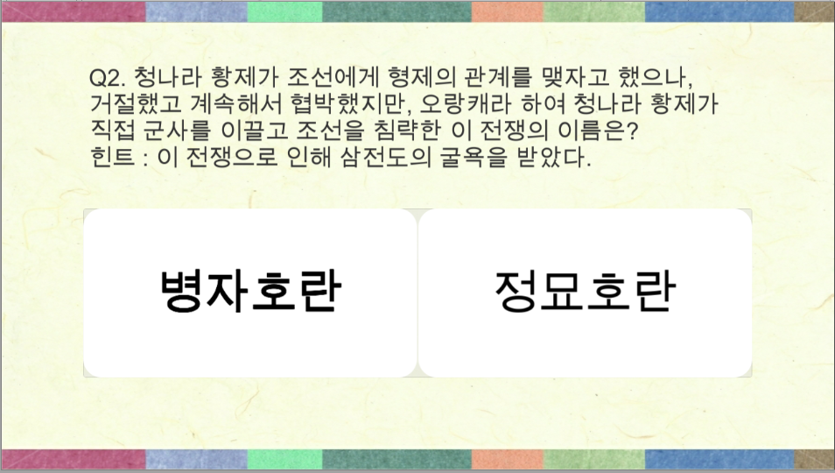
Implement Features
Cultural Heritage Experience Game
02
Quiz
a quiz of Silla period a quiz of Chosun period
Every stage has a quiz.
By each stage, Bulguksa Temple was during the Silla Period,
Changdeokgung Palace presents the historical quiz questions of the Chosun period.
- The quiz questions are 20 questions randomized by period.
Notes:
http://minheeblog.tistory.com/category/PPT

Slide 6
Implement Features
Cultural Heritage Experience Game
02
Randomize quiz video
Notes:
http://minheeblog.tistory.com/category/PPT

Slide 7
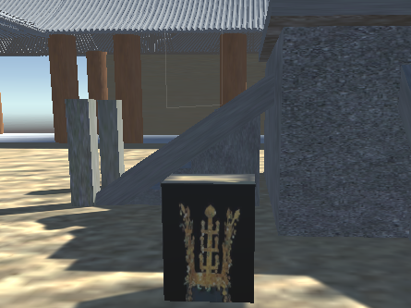
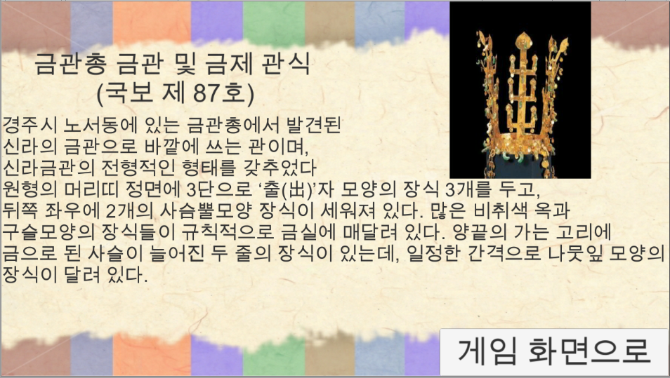
Implement Features
Cultural Heritage Experience Game
02
Item function
There are items of artifacts all over the stage.
If you approach an item, you will be introduced to the artifact.
Item is from each stage period
Clear can be done by collecting all items and solving 4 quizzes.
Notes:
http://minheeblog.tistory.com/category/PPT

Slide 8
Play video
Cultural Heritage Experience Game
03
VR Implementation – Title and Stage Select
Notes:
http://minheeblog.tistory.com/category/PPT

Slide 9
Play video
Cultural Heritage Experience Game
03
Play video
Notes:
http://minheeblog.tistory.com/category/PPT

Slide 10
Play video
Cultural Heritage Experience Game
03
Play video
Notes:
http://minheeblog.tistory.com/category/PPT

Slide 11
Role & Development Environment
Cultural Heritage Experience Game
04
Role
Choe ju ho : Script creation, feature implementation, VR interwork
Hong dae hwa : Investigate data, stage production, quizzes and items
Development Environment
Game Engine : Unity (ver. 2018.3.13.f1)
IDE : Visual Studio 2017 (C# Scripct)
Platform : VR Device (HTC vive)
OS : Windows 10 (Pro x64)
Notes:
http://minheeblog.tistory.com/category/PPT

Slide 12
Cultural Heritage Experience Game
Q & A
Notes:
http://minheeblog.tistory.com/category/PPT

Slide 13
Cultural Heritage Experience Game
THANK
YOU
Notes:
http://minheeblog.tistory.com/category/PPT

